Slide 1
Final Project
DATA130030.01 (自然语言处理)
School of Data Science Fudan University
04/03/2024

Slide 2
Final project overview
The goal of our course project is to solve NLP tasks/problems using NLP techniques and methods.
It is a great opportunity for you to apply your newly acquired skills in NLP towards an in-depth application and/or research problem.
You should pick something you are passionate about or something you find interesting.
When selecting a project, you should make sure that you can find an well-defined dataset that you can use for your project.

Slide 3
Project types and your team
Possible projects types from or include
Our existing course project list
Re-implementing / reproducing a recent paper
Applying an existing models to a new task
Proposing a new models or a new variation of an existing model
Experimental and/or theoretical analysis of a NLP model
Others …
About your team
No more than 3 group members

Slide 4
Example Task 1 Aspect Based Sentiment analysis
Task: Predict the aspect-based sentiment polarity for each instance in the test files, and write your predicted labels in result files. The labels in test files are only for evaluation
Datasets: https://alt.qcri.org/semeval2014/task4/index.php?id=data-and-tools Each sample contains
id: the sentence id
text: the text content
aspect:start-end: “aspect” denotes the aspect term mentioned in the text, and “start-end” denotes the start and end character index of the aspect term occurred in the text
label: the sentiment label (positive, negative, and neutral) specific to an aspect
This project is based on subtask 2 of SemEval-2014 Task 4: Aspect Based Sentiment Analysis. http://alt.qcri.org/semeval2014/task4/
You need to to design methods for sentiment classification specific to an aspect.
For example
“Even though its good seafood, the prices are too high”.
This sentence contains two aspects, namely “seafood” and “prices”. The sentiment for the two aspects are positive and negative respectively.

Slide 5
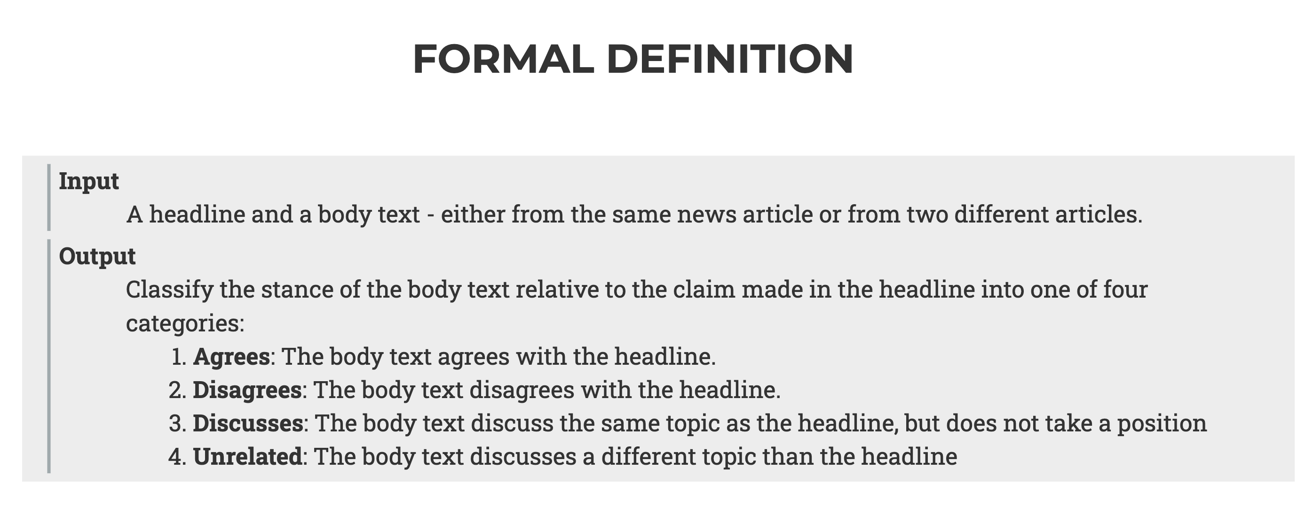
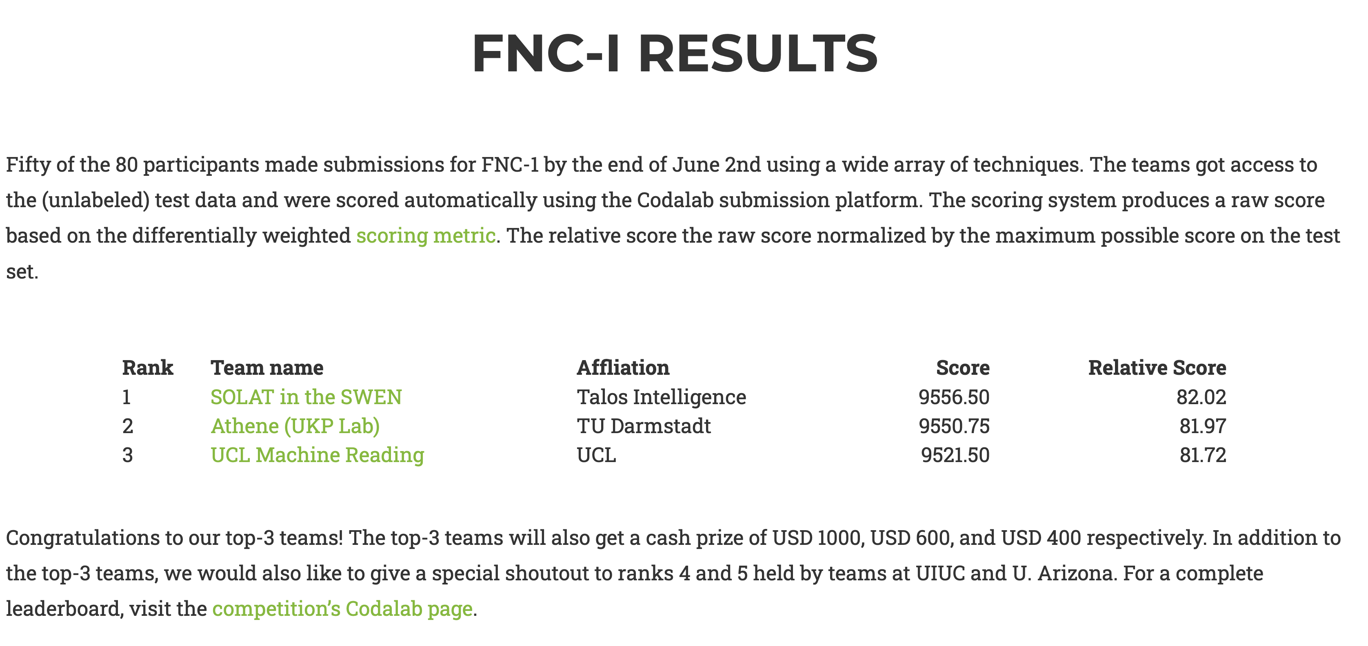
Example Task 2 Fake News Challenge
This project is borrowed from a public challenge for fake news detection. Details can be found in http://www.fakenewschallenge.org/ including the dataset.
Report and implementation of the top-3 teams can be found at the bottom.
You are required to implement at least one of their models. A novel model for this task is highly encouraged.

Slide 6
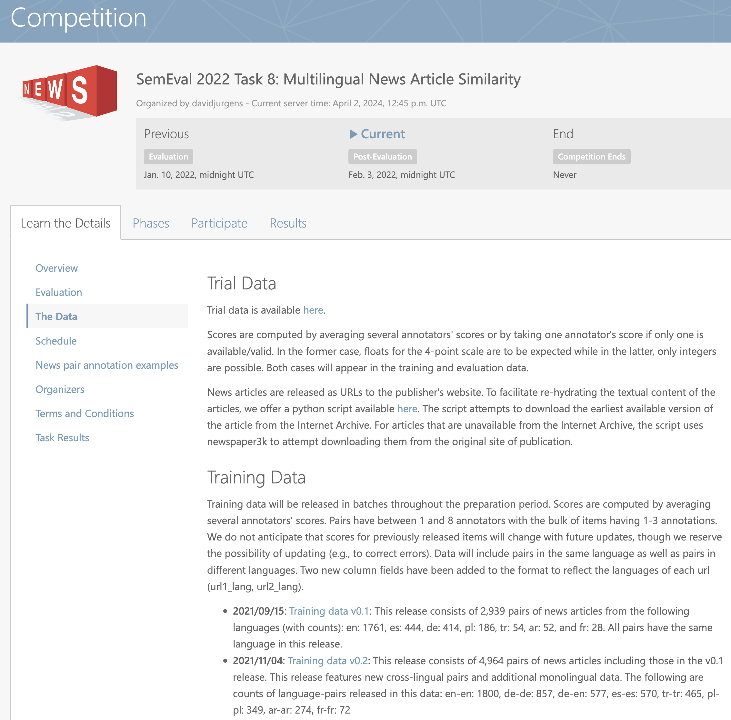
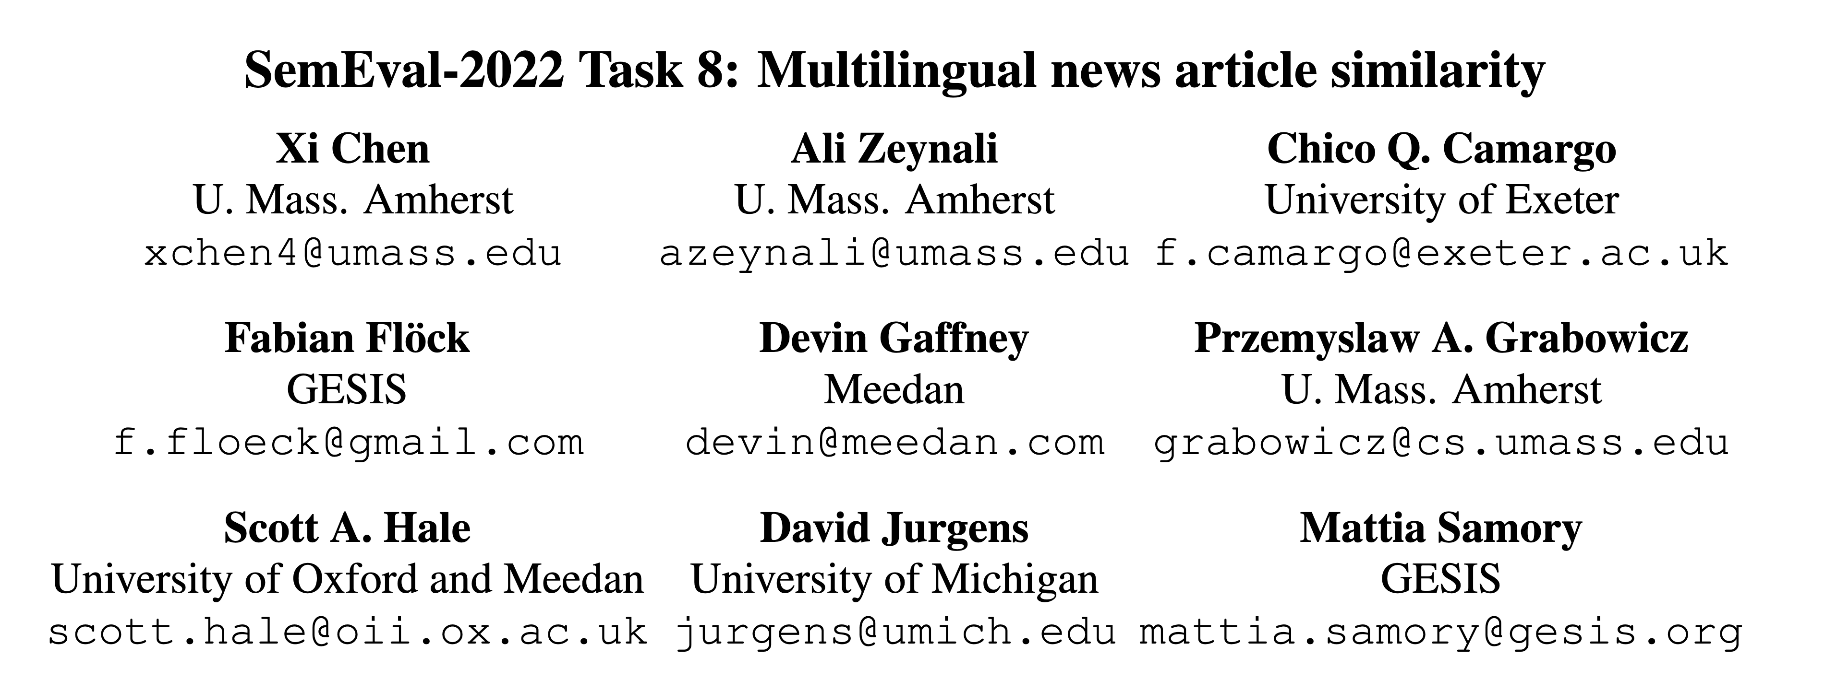
Example Task 3 SemEval 2022 Task 8: Multilingual News Article Similarity
The task is: Given a pair of news articles, are they covering the same news story?
This SemEval task aims to develop systems that identify multilingual news articles that provide similar information
This is a document-level similarity task in the applied domain of news articles, rating them pairwise on a 4-point scale from most to least similar
https://competitions.codalab.org/competitions/33835
Paper: https://aclanthology.org/2022.semeval-1.155.pdf
Example code: https://github.com/upura/semeval2022-task8-multilingual-news-article-similarity
This year: https://semeval.github.io/SemEval2024/

Slide 7
Example Task 4 Commonsense Validation and Explanation (Task A)
Task A: Commonsense Validation
Choose from two natural language statements to judge which one is against commonsense.
Example:
Which statement of the two is against commonsense?
Statement 1: He put a turkey into the fridge.
Statement 2: He put an elephant into the fridge (against commonsense).
Input
Two statements (sent0, sent1) with similar words.
Output
0 or 1
0 means sent0 is against commonsense, while 1 means sent1 is against commonsense.
This project is based on the ACL 2019 paper
Does It Make Sense? And why? A Pilot Study for Sense Making and Explanation
There are two subtasks: task A and task B. You can choose either one for your project or both.
You are required to implement at least one of the models except Random in the paper, or devise your own methods to improve the performance.
Datasets: https://github.com/wangcunxiang/SemEval2020-Task4-Commonsense-Validation-and-Explanation

Slide 8
Example Task 5 Commonsense Validation and Explanation (Task B)
This project is based on the ACL 2019 paper
Does It Make Sense? And why? A Pilot Study for Sense Making and Explanation
There are two subtasks: task A and task B. You can choose either one for your project or both.
You are required to implement at least one of the models except Random in the paper, or devise your own methods to improve the performance.
Datasets: https://github.com/wangcunxiang/SemEval2020-Task4-Commonsense-Validation-and-Explanation
Task B: Commonsense Explanation
Find the key reason from three options to explain why a given statement does not make sense.
Example
Statement: He put an elephant into the fridge.
Reasons
A: An elephant is much bigger than a fridge. (correct explanation)
B: Elephants are usually white while fridges are usually white.
C: An elephant cannot eat a fridge.
Input
One statement against commonsense and three options for explanation.
Output
A, B or C

Slide 9
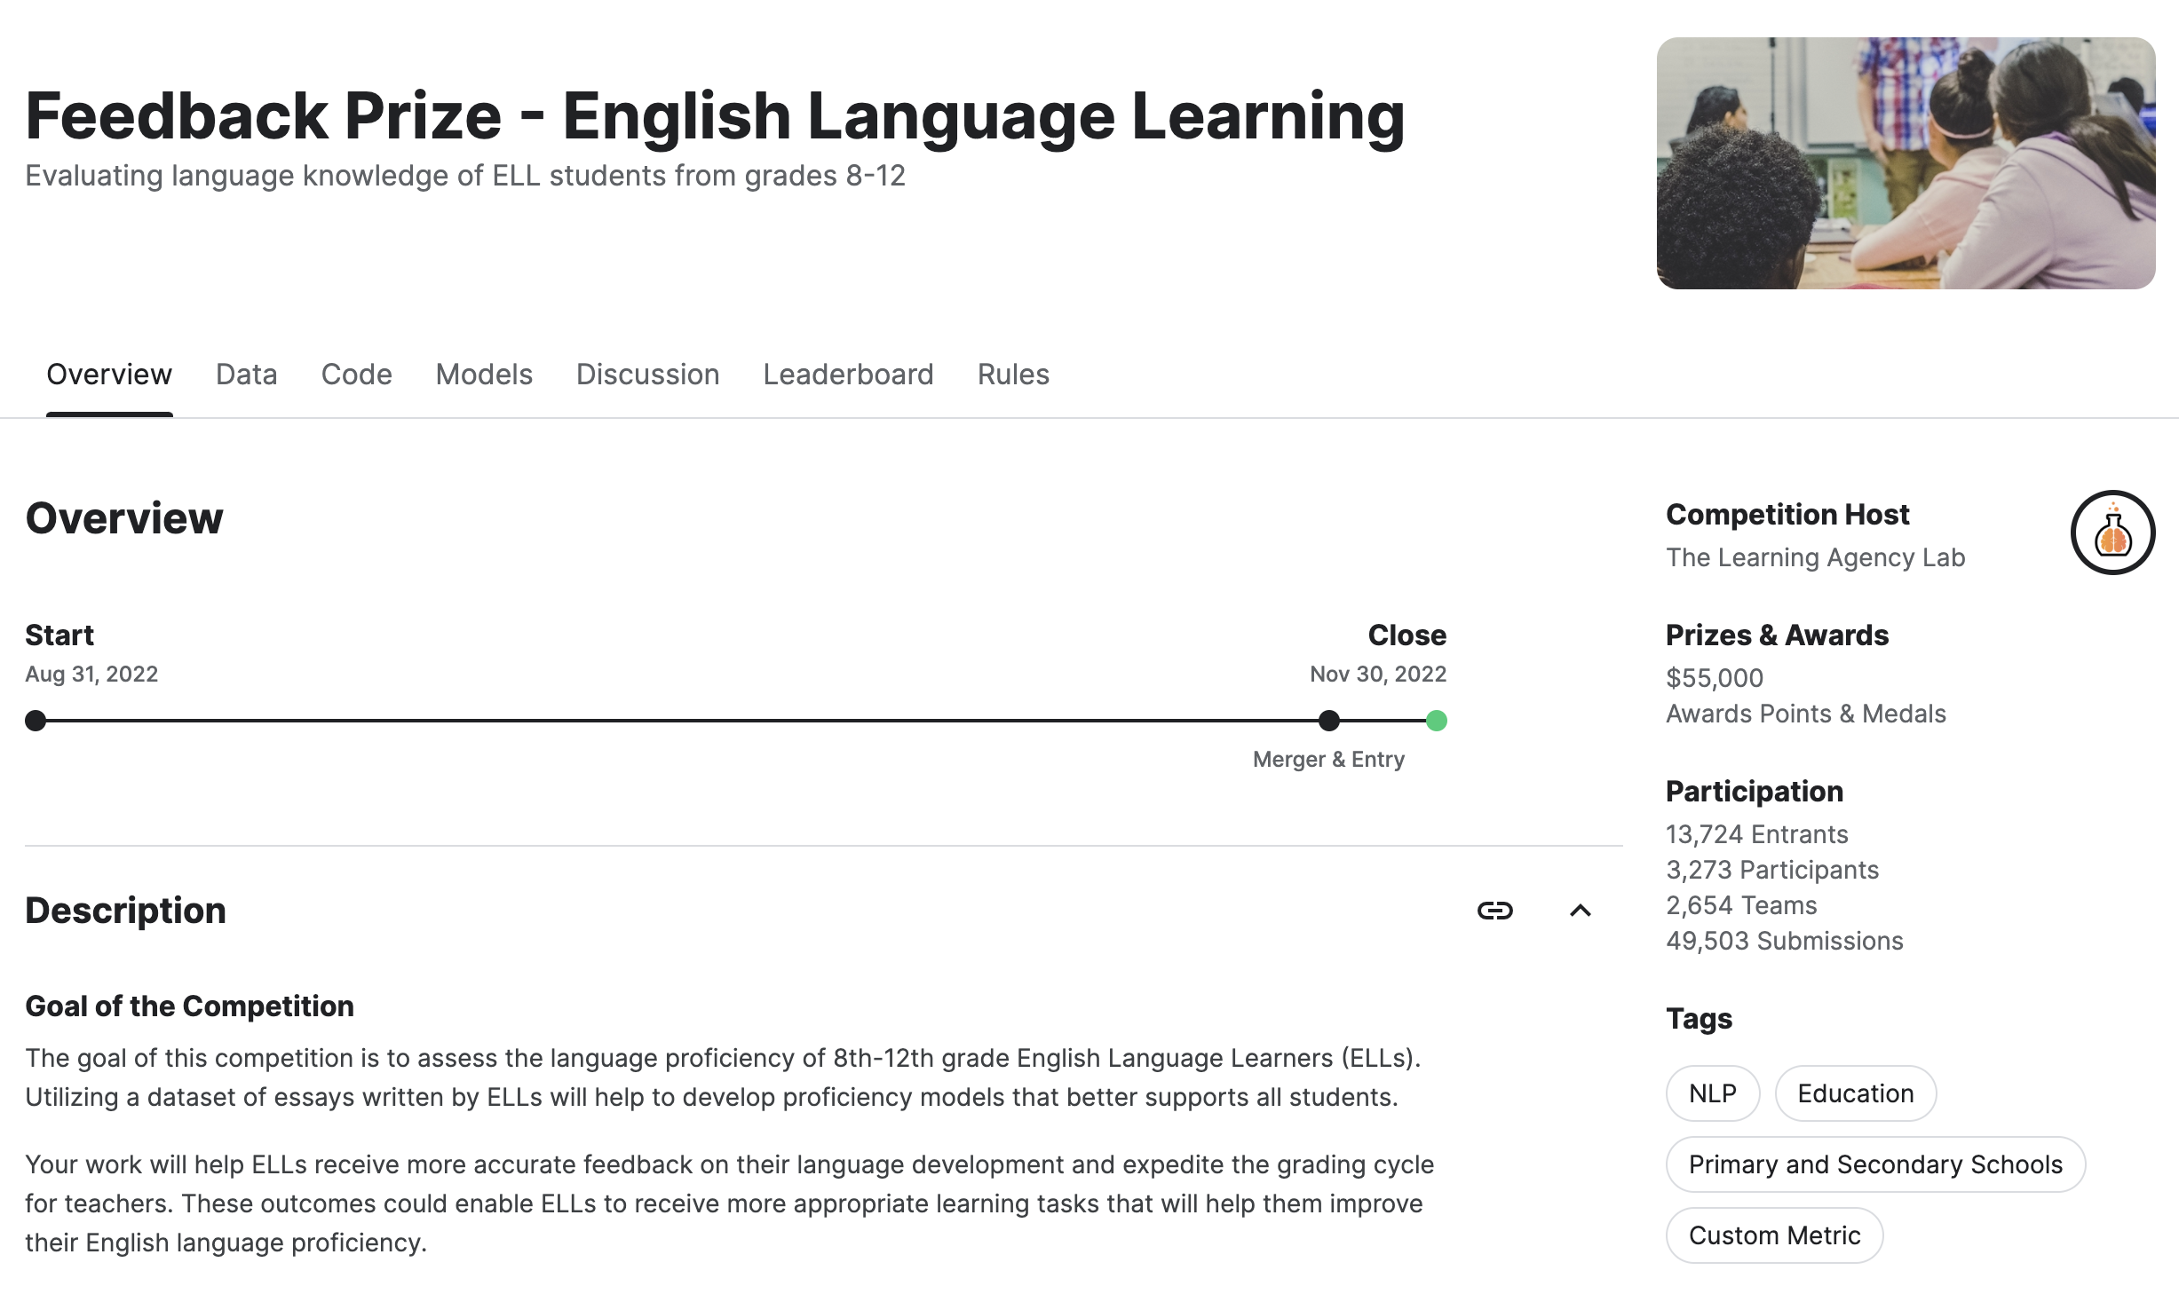
Example Task 6 Feedback Prize - English Language Learning
The task is: Assess the language proficiency of 8th-12th grade English Language Learners (ELLs)
This task aims to receive more accurate feedback on their language development and expedite the grading cycle for teachers.
https://www.kaggle.com/competitions/feedback-prize-english-language-learning/data
Example solution: https://www.kaggle.com/competitions/feedback-prize-english-language-learning/code

Slide 10
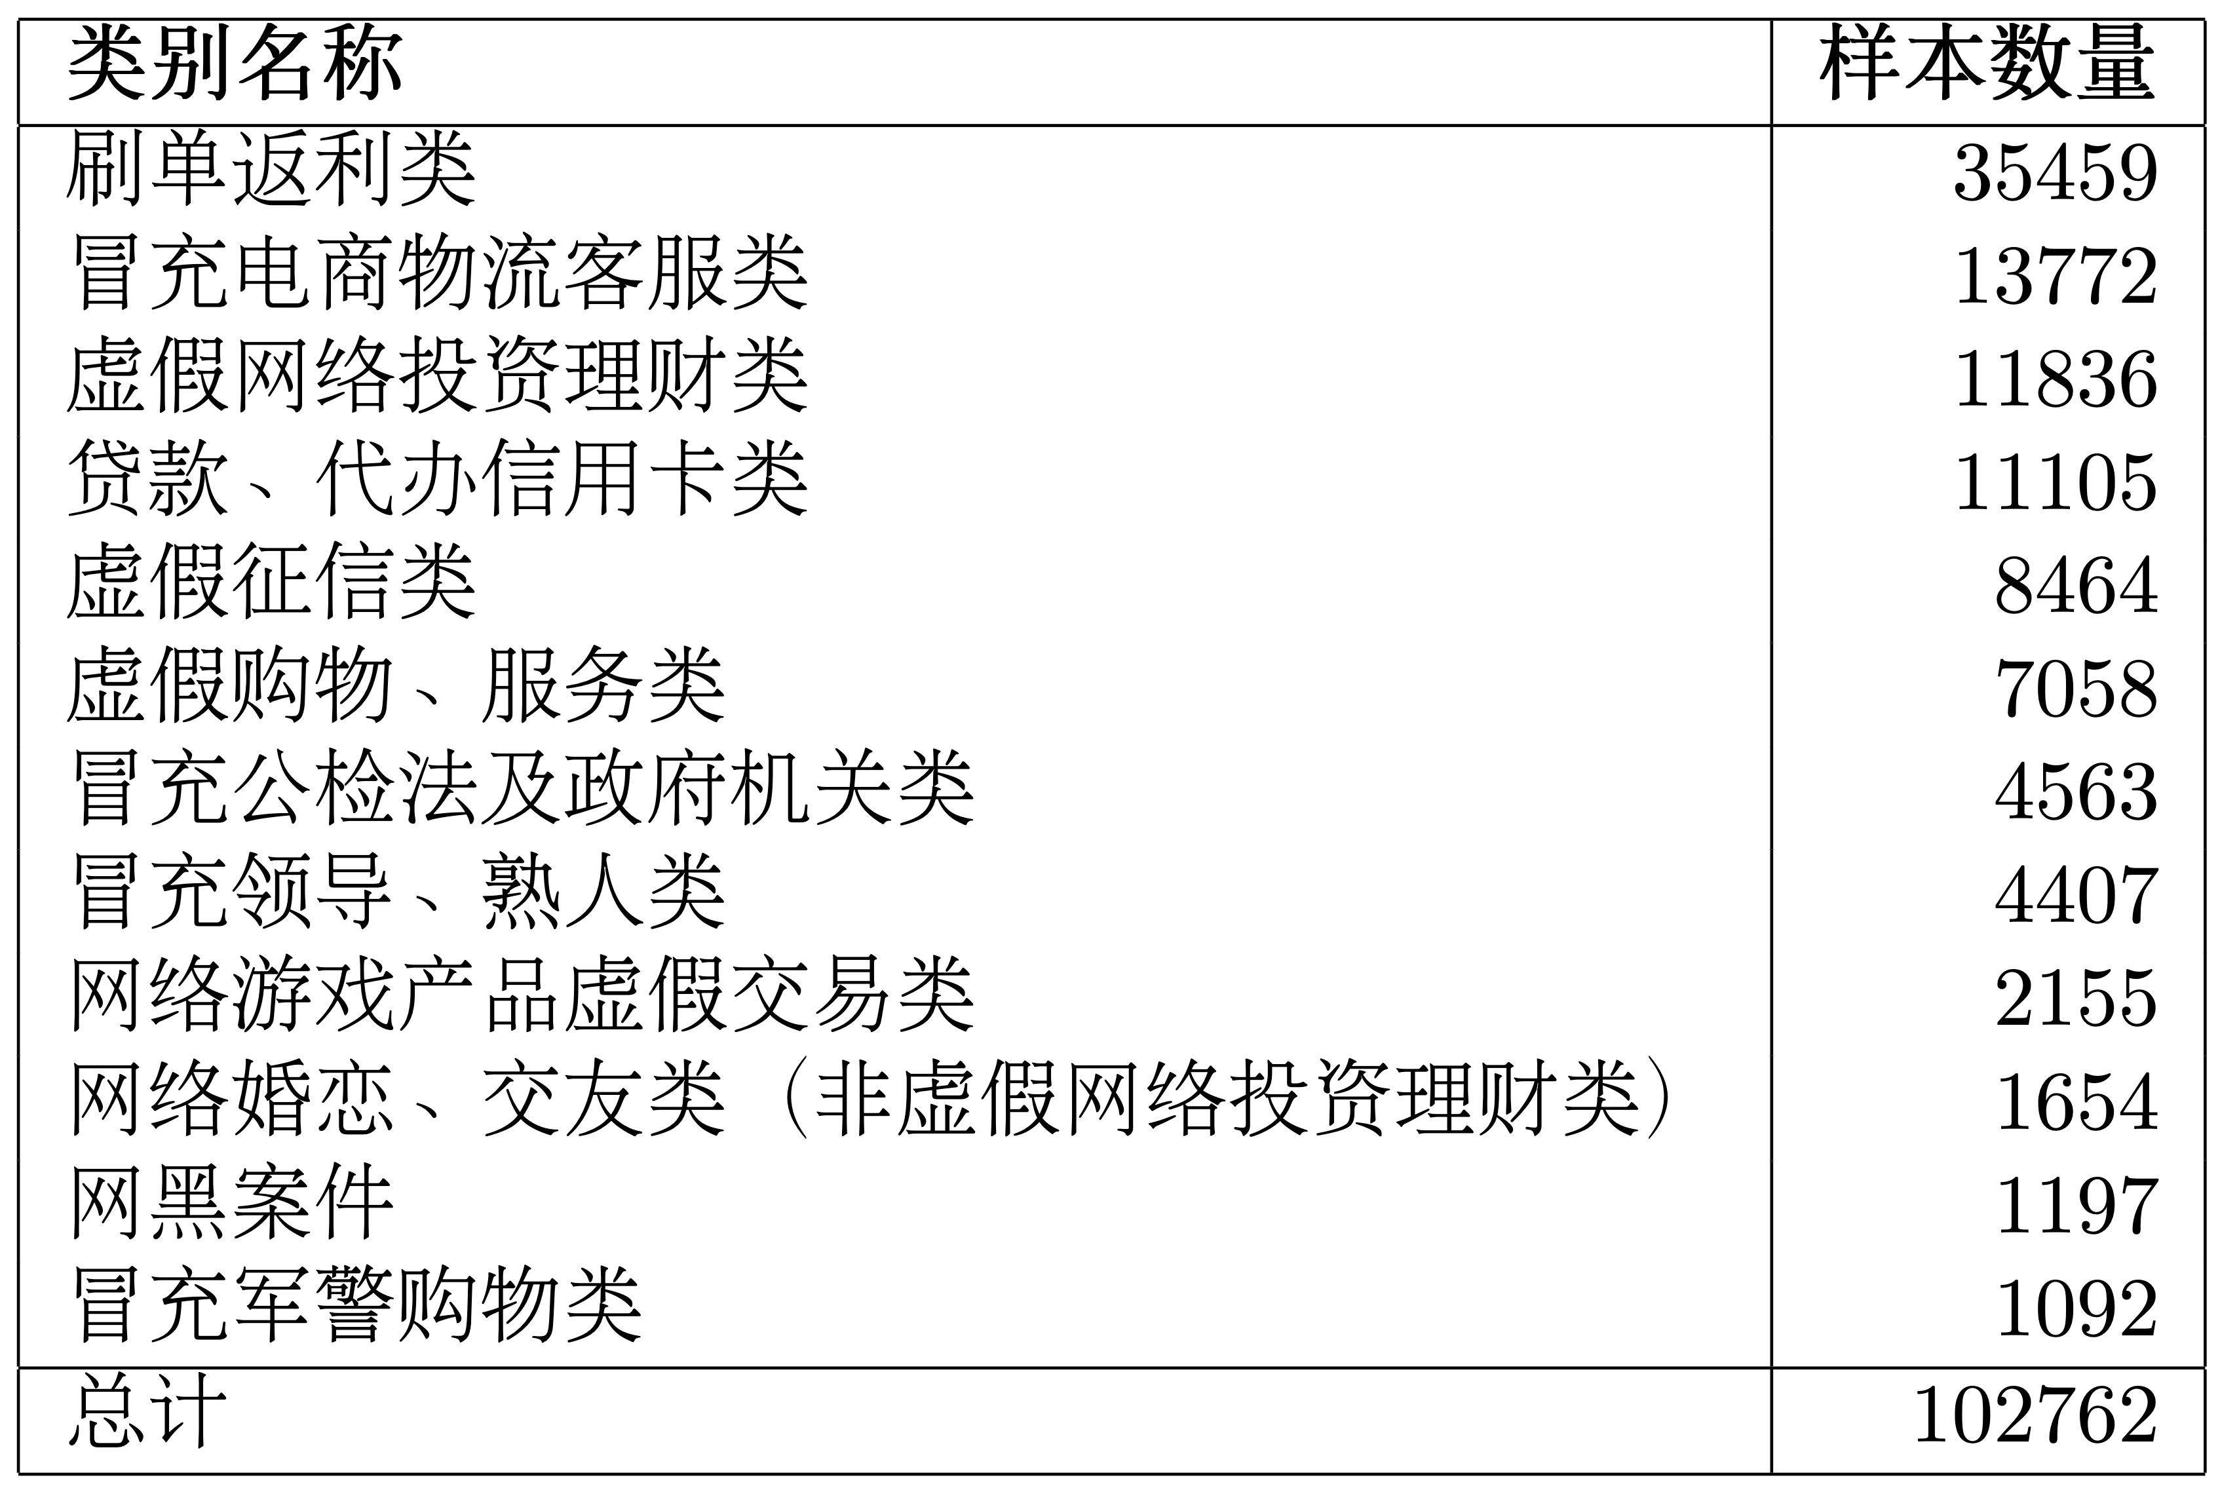
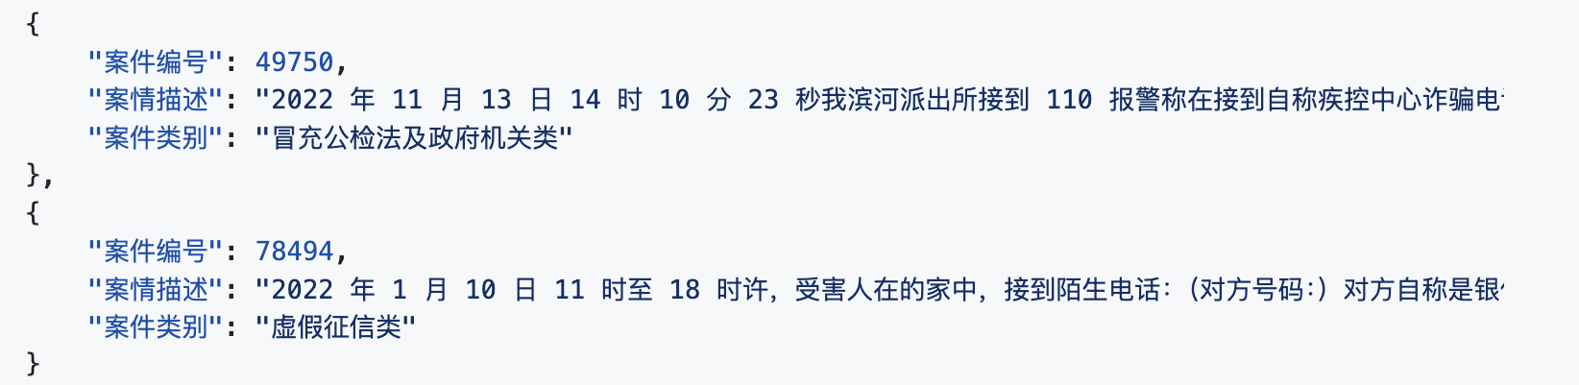
Example Task 7 CCL 2023 电信网络诈骗案件分类评测
本任务目标：对给定案件描述文本进行分类。案件文本包含对案件的整体描述（经过脱敏处理）。从反诈大数据平台共计导出 13 个类别的数据，去除了“其他类型诈骗”类别，因此最终采用 12 个类别。
目的在于统计现状，有助于公安部门掌握当前电信网络诈骗案件的分布特点，进而能够对不同类别的诈骗案件作出针对性的预防、监管、制止、侦查等措施。
https://github.com/GJSeason/CCL2023-FCC
Paper: https://aclanthology.org/2023.ccl-3.21.pdf

Slide 11
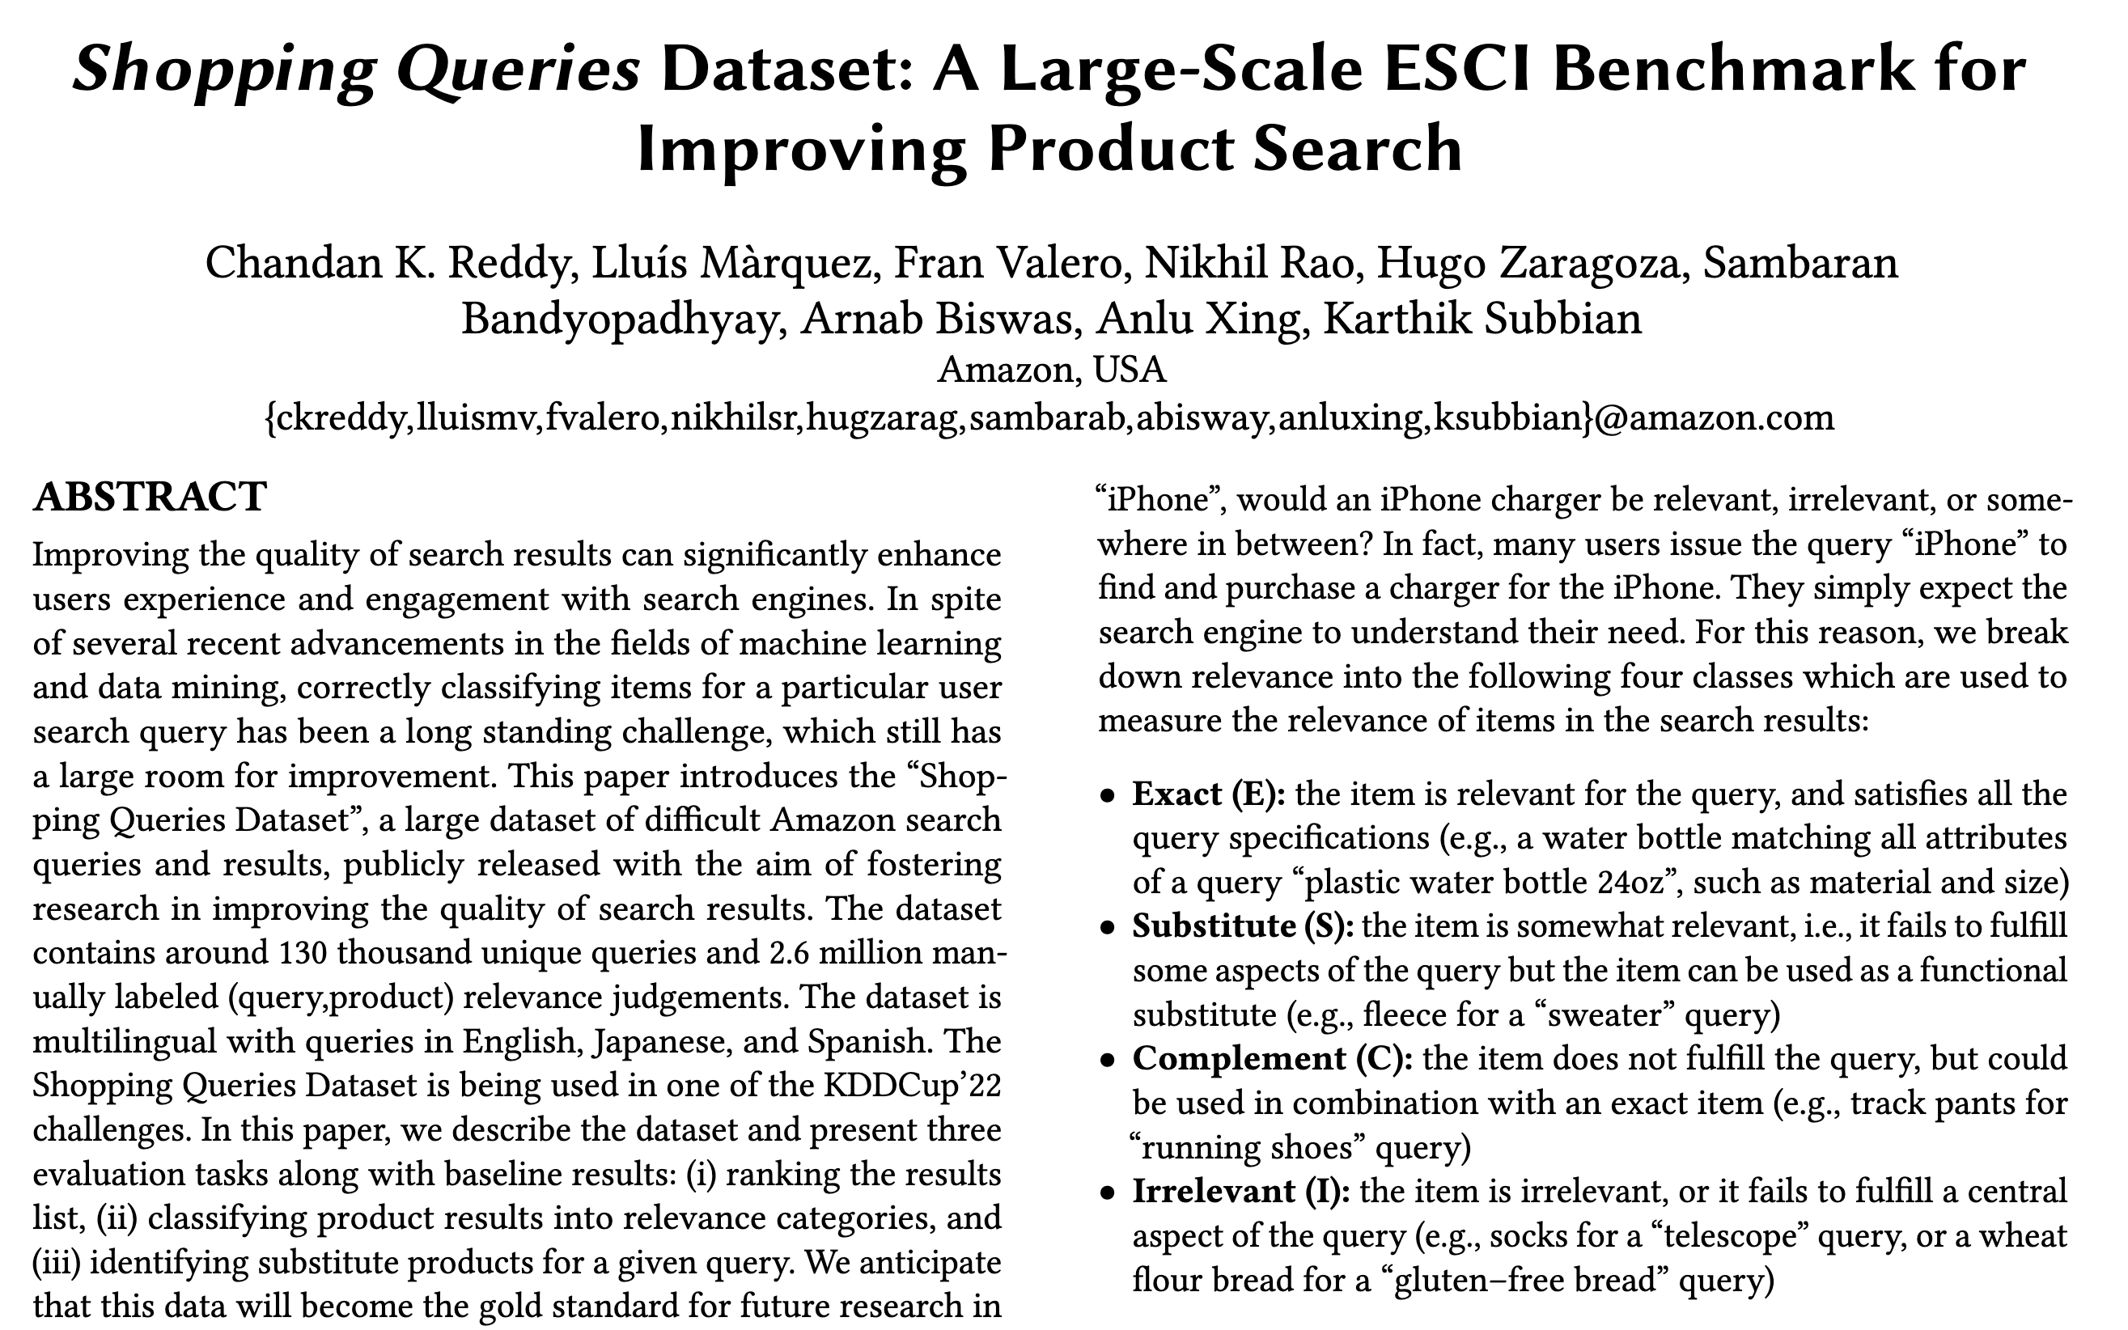
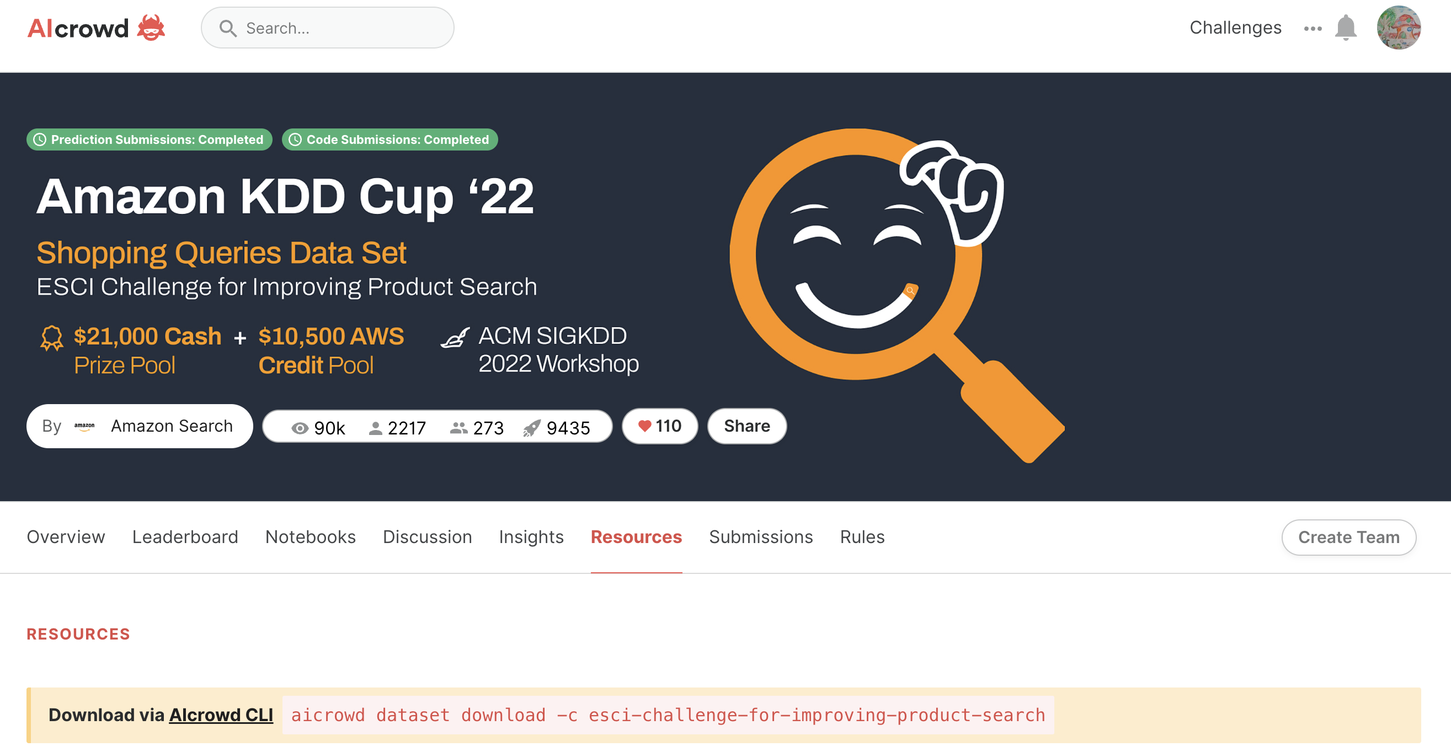
Example Task 8 Multiclass Product Classification
Task: Given a query and a result list of products retrieved for this query, the goal of this task is to classify each product as being an Exact, Substitute, Complement, or Irrelevant match for the query.
https://www.aicrowd.com/challenges/esci-challenge-for-improving-product-search

Slide 12
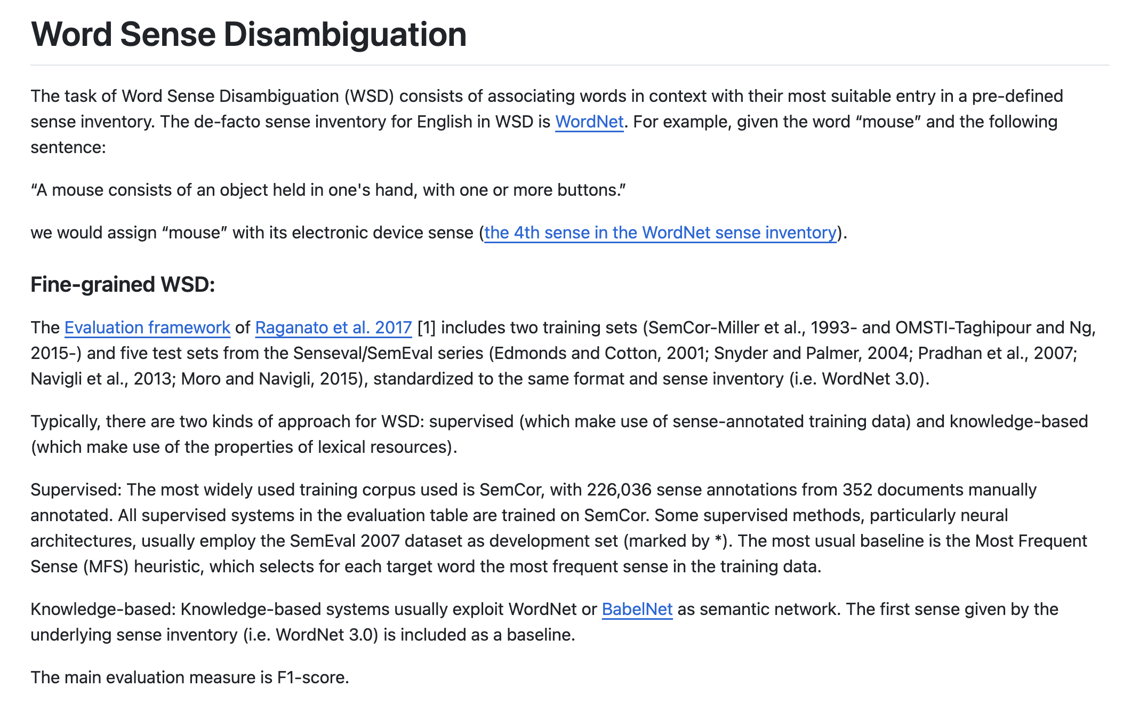
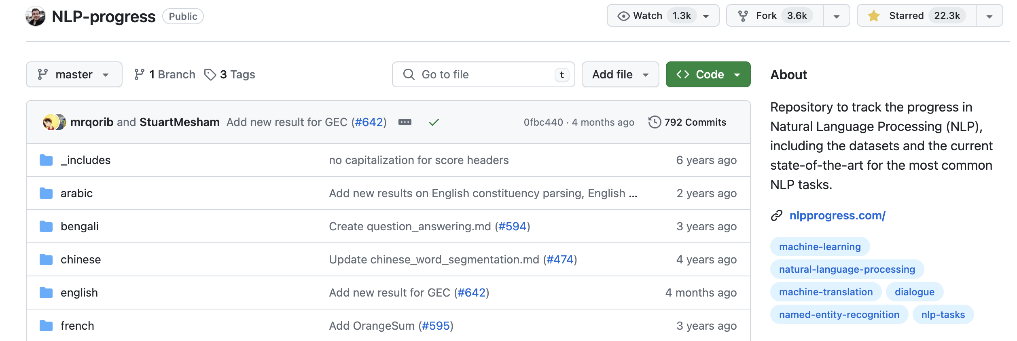
Example Task 9 Other Tasks (Ruder’s list)
https://github.com/sebastianruder/NLP-progress

Slide 13
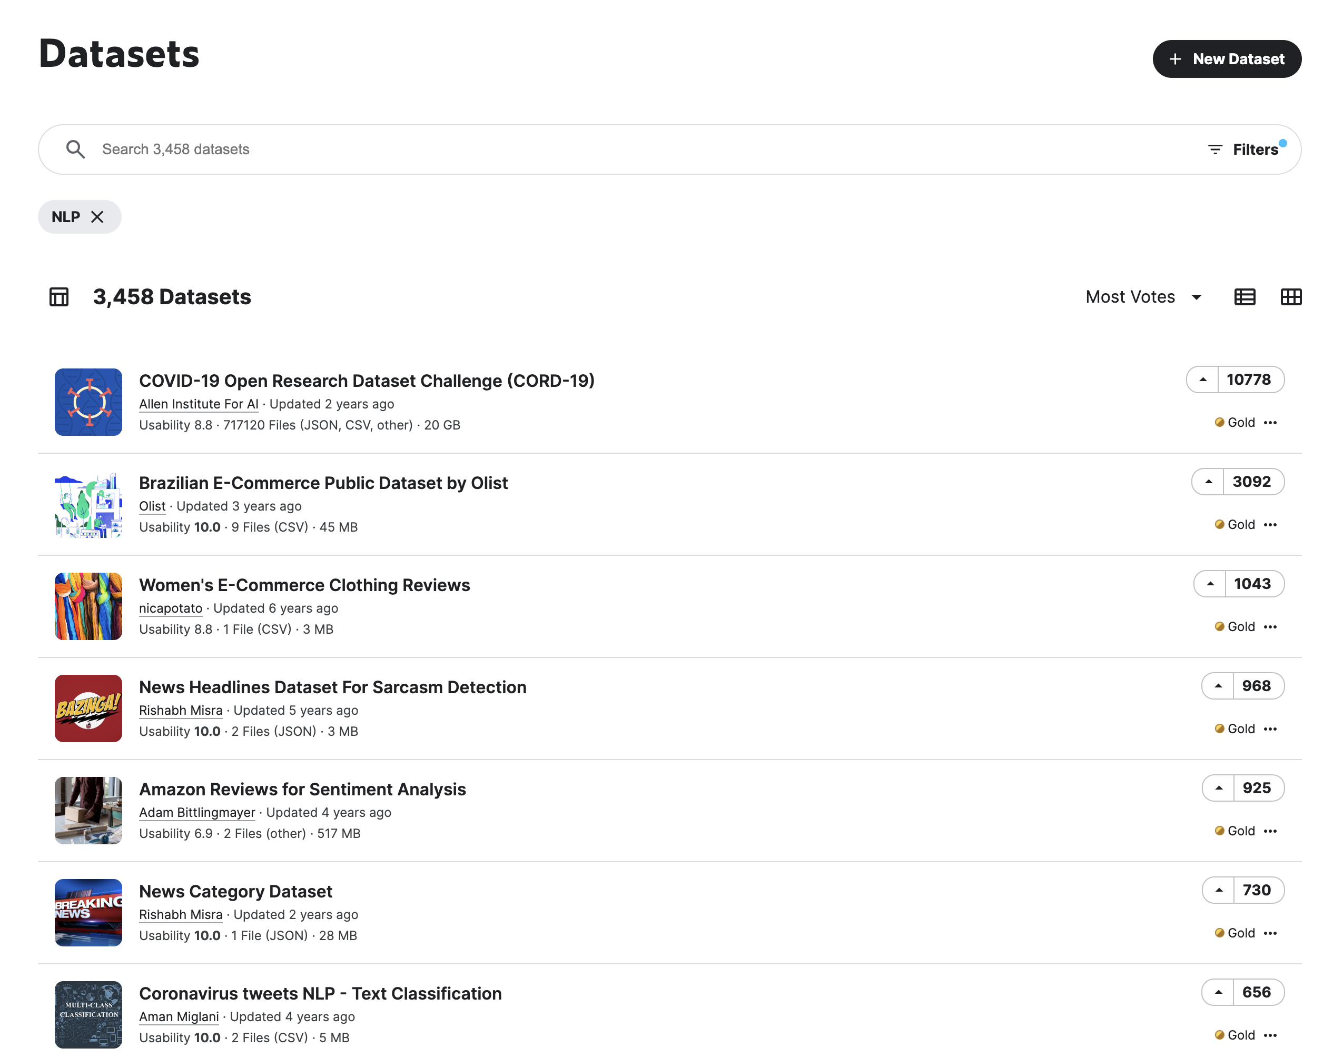
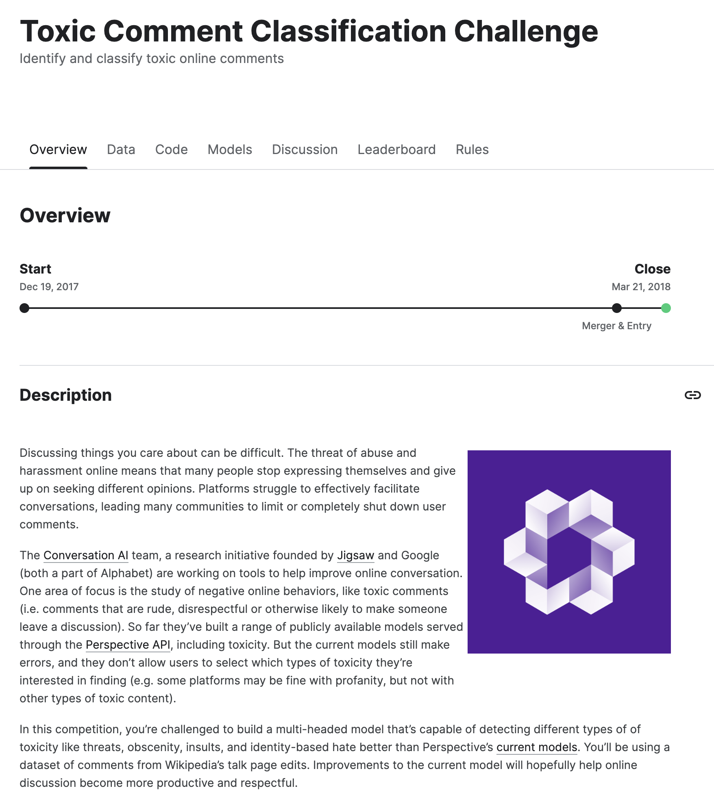
Example Task 10 Other Tasks (Kaggle datasets, NLP)
https://www.kaggle.com/datasets
https://www.kaggle.com/c/jigsaw-toxic-comment-classification-challenge

Slide 14
Other useful resources
Angel Chang’s course
https://angelxuanchang.github.io/nlp-class/project_titles
https://angelxuanchang.github.io/nlp-class/project_titles
MIND News Recommendation System with OpenAI’s Pre-trained embeddings
English and Japanese Machine Translator
Polyglot Refinement: Neural Machine Translation for Low Resource Languages
Research Paper Summarization
Comparative Analysis of Adversarial Attacks on BERT-based NLP Models
Text Summarization of Academic Papers
Grammatical Error Correction using Recurrent Neural Networks
Syntactic Aware Cross Modality Alignment for Vision Language Navigation
Chatting Bot
…
Stanford 224N
https://web.stanford.edu/class/cs224n/slides/cs224n-2024-lecture07-final-project.pdf
https://web.stanford.edu/class/archive/cs/cs224n/cs224n.1234/project.html

Slide 15
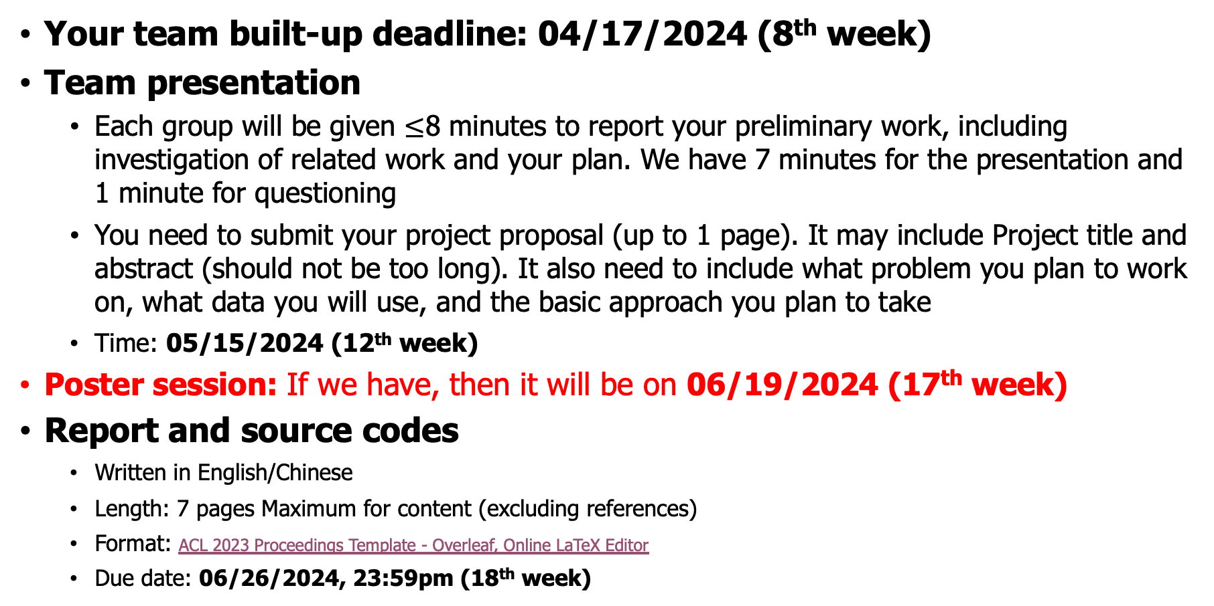
Evaluation timeline
Your team built-up deadline: 04/17/2024 (8th week)
Team presentation
Each group will be given $≤$8 minutes to report your preliminary work, including investigation of related work and your plan. We have 7 minutes for the presentation and 1 minute for questioning
You need to submit your project proposal (up to 1 page). It may include Project title and abstract (should not be too long). It also need to include what problem you plan to work on, what data you will use, and the basic approach you plan to take
Time: 05/15/2024 (12th week)
Poster session: If we have, then it will be on 06/19/2024 (17th week)
Report and source codes
Written in English/Chinese
Length: 7 pages Maximum for content (excluding references)
Format: ACL 2023 Proceedings Template - Overleaf, Online LaTeX Editor
Due date: 06/26/2024, 23:59pm (18th week)

Slide 16
Evaluation timeline
Evaluation based on the four criteria
Project proposal (5%): Clarity, feasibility, relevance, innovation, and potential impact
Presentation (20%): Clarity/Enough related work, etc.…
Programing and algorithm design (25%): Reasonable and Solid/Soundness
Performance (20%): Good results/Analysis
Report (25%-30%): Well organized, appropriate analyses and discussions
Poster session (0%-5%) ?
All students in a group suppose to receive the same final project score
Any questions, please send email to TA or me

Slide 17
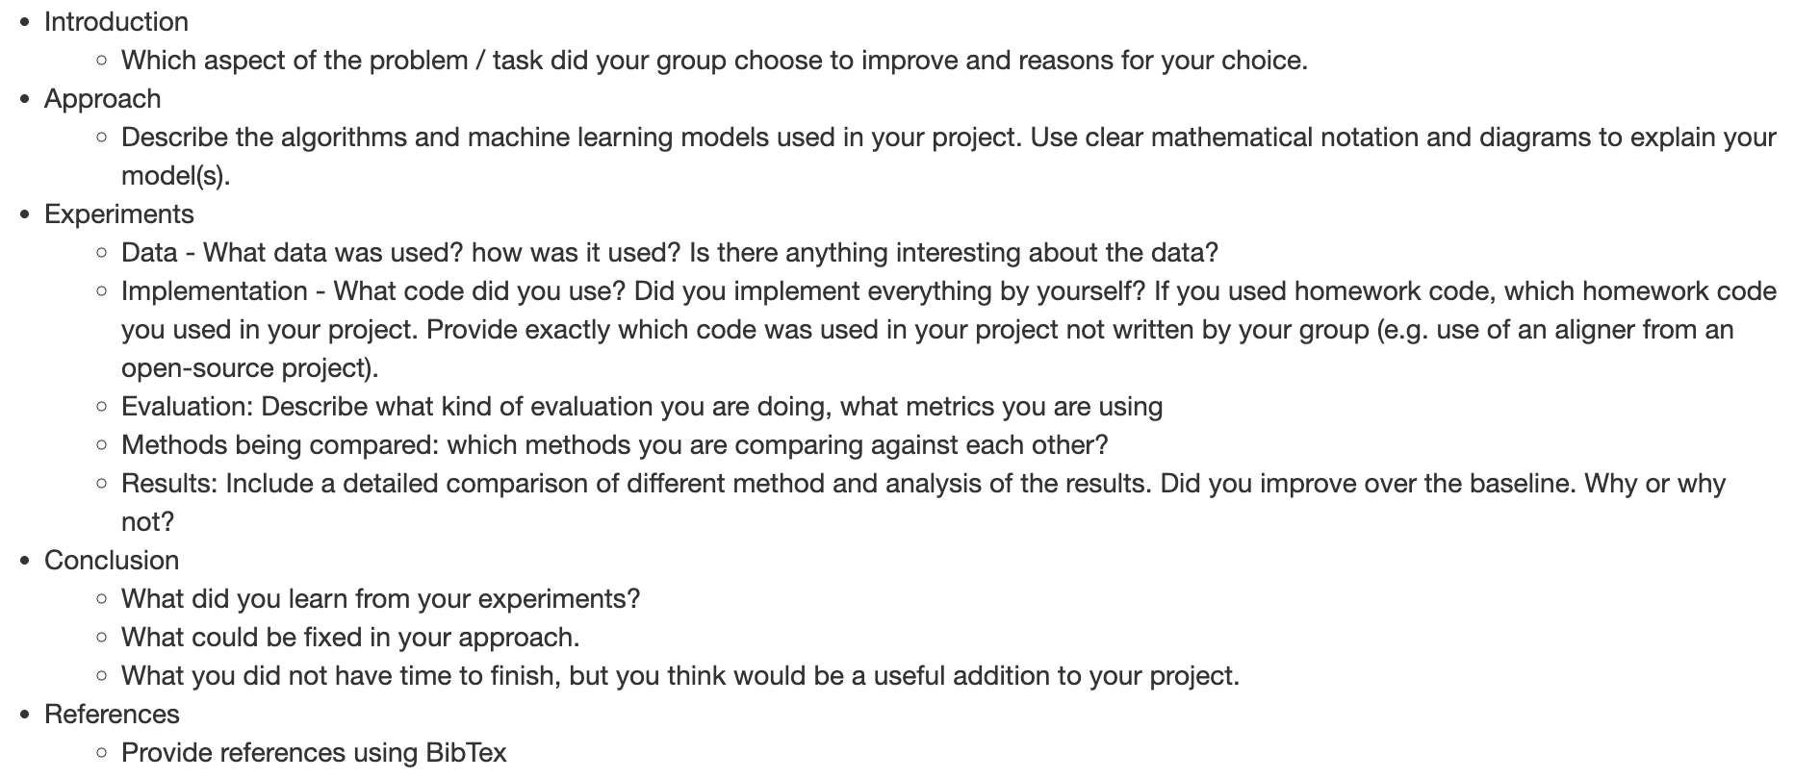
Outline of the report
You may consider the following items
Abstract/Introduction/ Review the previous work of your task
Dataset(s) you plan to use, e.g. Tweets
Data preprocessing
Methods
Results/Evaluations
Discussion/Conclusion
References
https://angelxuanchang.github.io/nlp-class/project.html

Slide 18
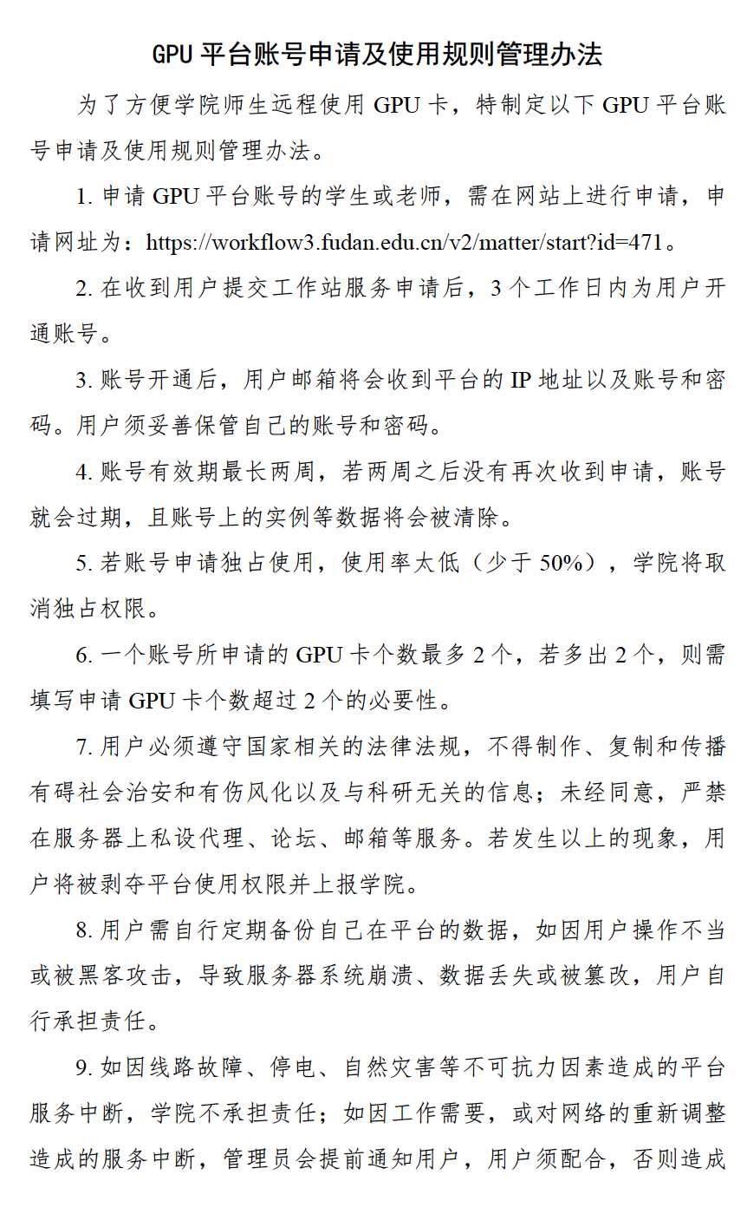
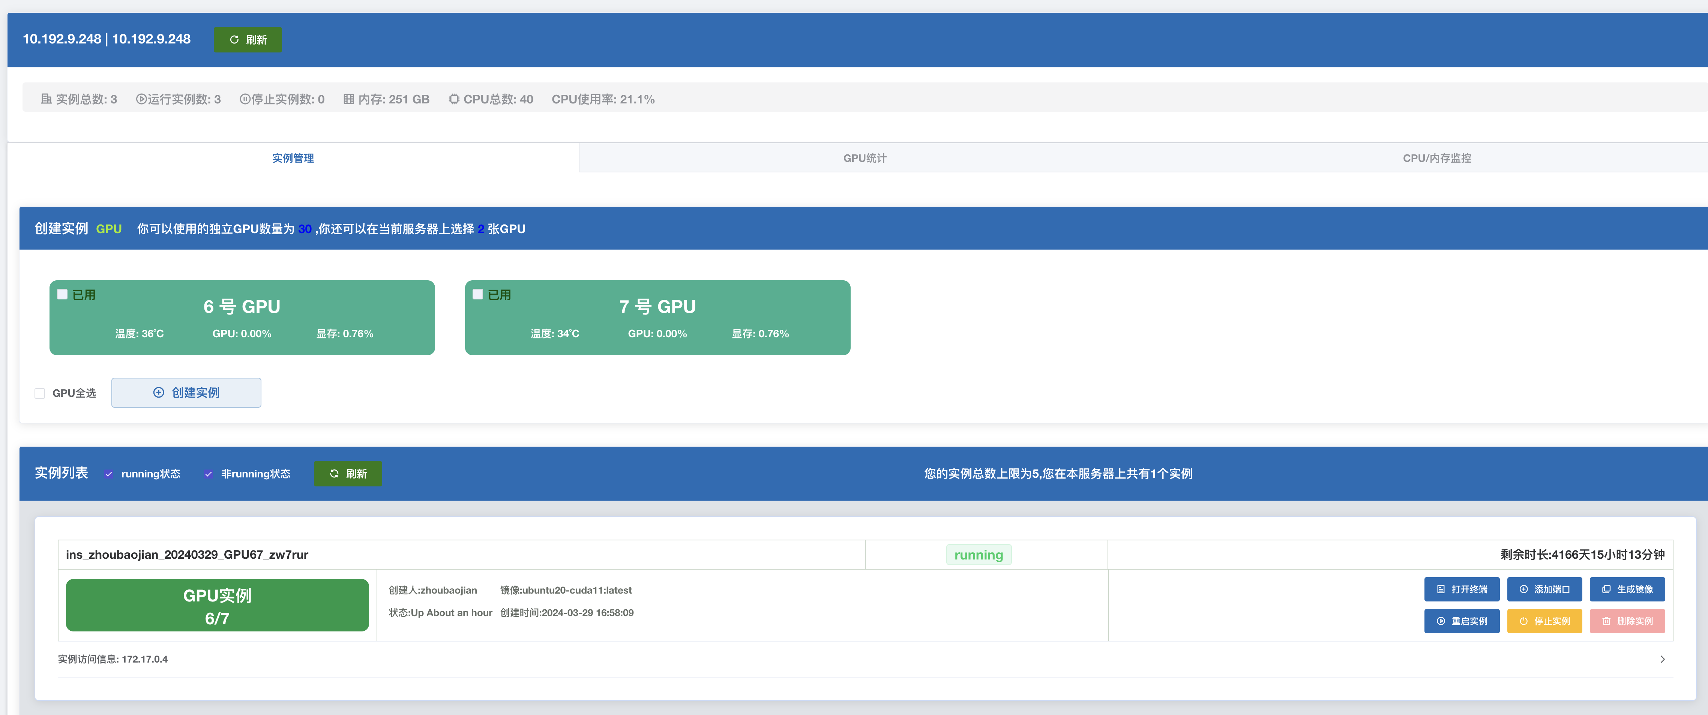
GPU resources configure your server
http://10.192.9.50:18888/dashboard
Follow instructions and don’t do stupid things

Slide 19
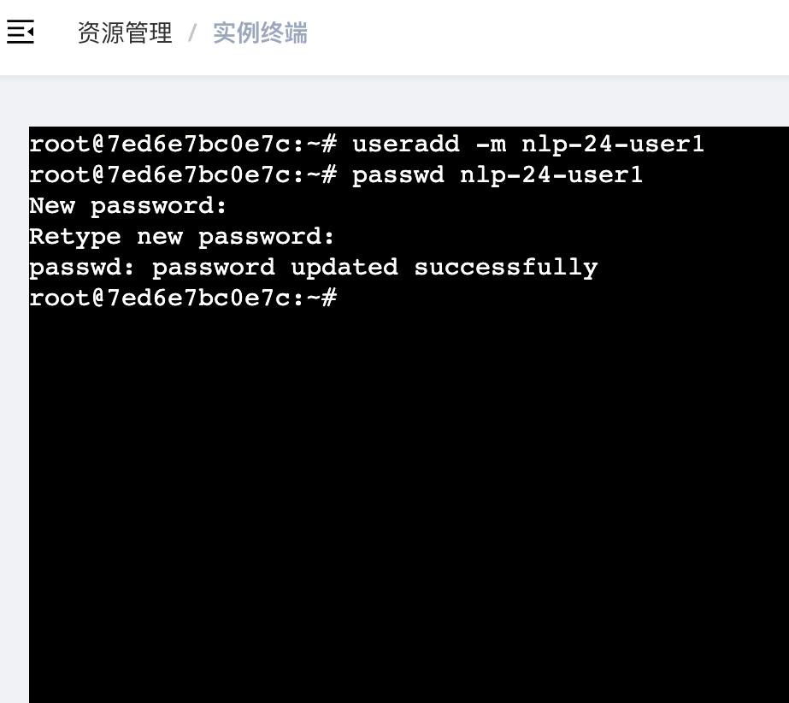
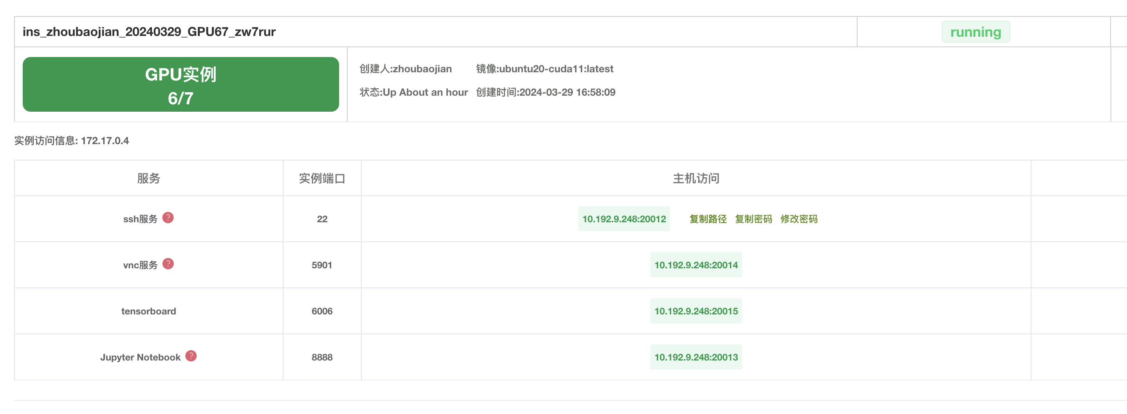
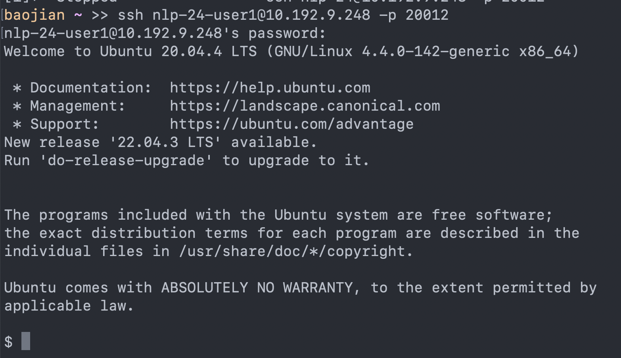
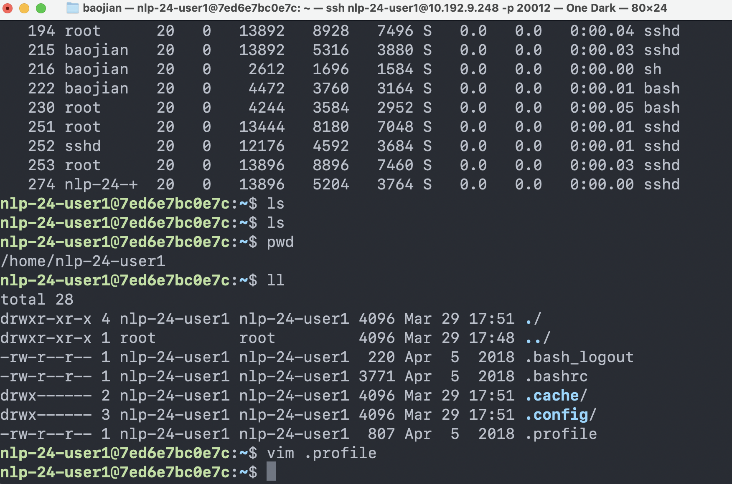
GPU resources configure your server
GPU resources are limited. Please manage your GPU requirements judiciously.

Slide 20
References
Some pages or ideas are from
[1] https://angelxuanchang.github.io/nlp-class/project.html
[2] https://nlp.stanford.edu/courses/cs224n/
[3] https://web.stanford.edu/class/archive/cs/cs224n/cs224n.1204/project.html
[4] https://web.stanford.edu/class/cs224n/project.html

